Slide 1

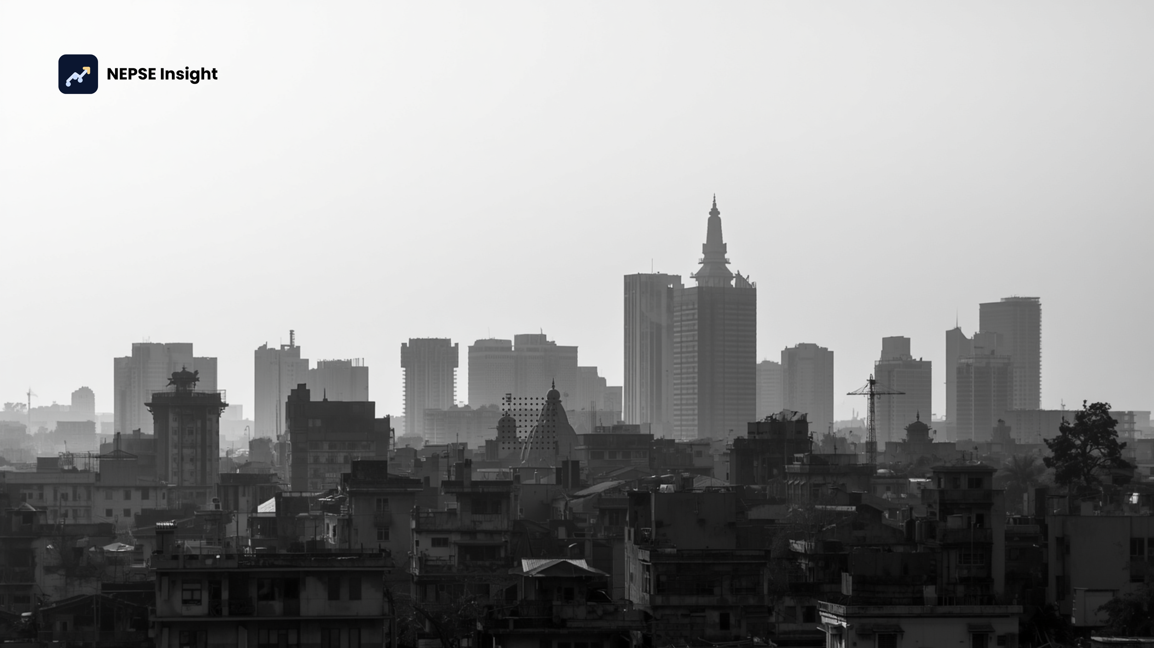
NEPSE Financial Report Analyzer
AI-powered Financial Statement Analysis for Hydropower Companies
Presented by
PRAKASH MAHARA
Notes:
1

Slide 2
Problem Statement
NEPSE-listed hydropower companies publish quarterly financial reports as lengthy PDF documents — but extracting meaningful insights from these reports is tedious, error-prone, and inaccessible to most investors.
Business Impact
Core Challenges
❌ Delayed Decisions
❌ Human Error Risk
Reports span multiple pages — difficult to analyze manually
Investors spend significant time locating key financial metrics
Quarter-to-quarter comparison requires manual calculations
Cross-company sector comparison is highly inefficient
Retail investors lack expertise to interpret complex statements
No intelligent platform for automatic NEPSE report analysis
Investment decisions are slowed by manual report reading
Manual ratio calculations introduce significant error potential
❌ Poor Comparability
❌ Limited Accessibility
Comparing multiple companies requires enormous manual effort
Non-financial users cannot interpret complex financial statements
Notes:
2

Slide 3
Proposed Solution
An AI-powered Financial Report Analyzer that automatically extracts, analyzes, and visualizes financial data from NEPSE quarterly reports — transforming raw PDFs into actionable investor intelligence.
7-Step System Workflow
Key Benefits
Upload Quarterly Report (PDF)
⏱ Time Savings
Eliminates hours of manual PDF reading and data entry
Automatic Data Extraction via pdfplumber
💡 Accessibility
Store Standardized Metrics in MySQL
Easy-to-understand insights for non-financial users
Generate Interactive Dashboards & Charts
✅ Accuracy
Reduces human error in ratio and metric calculations
AI-Powered Executive Summary & Insights
📈 Better Decisions
Company-to-Company Comparison
Supports data-driven investment decision-making
Download Investor-Friendly Reports
Notes:
3

Slide 4
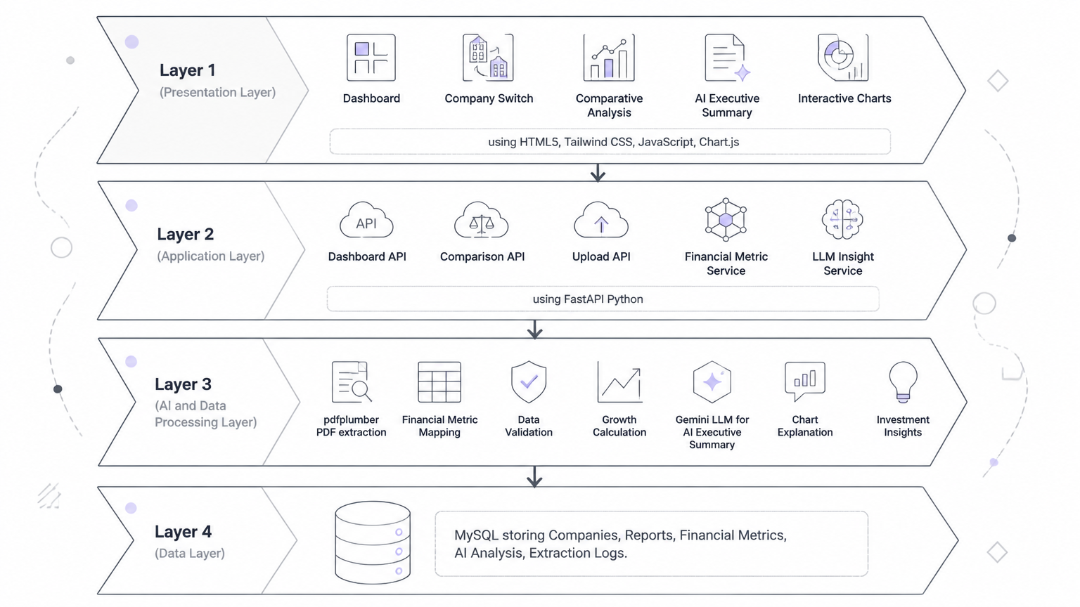
System Architecture
Notes:
4

Slide 5
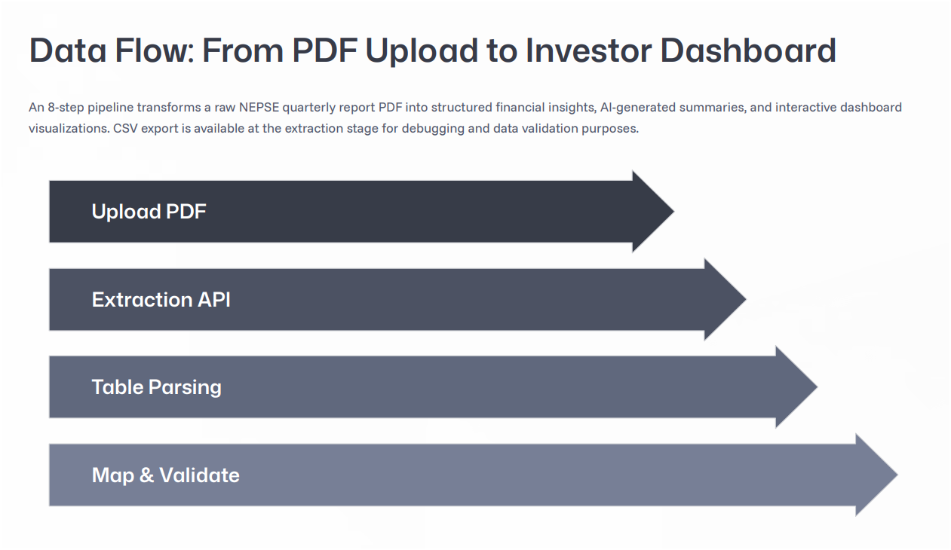

Slide 6
Key Features
Five core capabilities transform raw NEPSE PDF reports into a fully interactive financial intelligence platform.
Report Upload
Automated Extraction
Interactive Dashboard
Upload hydropower company quarterly financial reports in PDF format. The system accepts NFRS-compliant documents and queues them for automated processing.
pdfplumber parses and extracts NFRS financial metrics — revenue, net profit, assets, equity, EPS, and more — with a standardized metric mapping engine.
Visualizes Revenue, Net Profit, Total Assets, and Equity through dynamic Chart.js charts. Supports quarter-over-quarter trend analysis at a glance.
AI Insights
Company Comparison
LLM-generated executive summaries, trend explanations, and risk identification — translating complex financial data into plain-language investor narratives.
Side-by-side financial performance comparison between two NEPSE hydropower companies, with AI-generated comparative analysis highlighting key differences.
Notes:
5

Slide 7

Competitor Analysis
Unlike traditional tools that only display numbers, our platform extracts, analyzes, visualizes, and explains financial performance using AI — delivering capabilities unavailable in any existing workflow.
Feature
Manual Analysis
Excel
PDF Reader
Our System
PDF Data Extraction
❌
❌
❌
✅
Structured Financial Database
❌
Partial
❌
✅
Interactive Dashboard
❌
Limited
❌
✅
Quarter-over-Quarter Comparison
Manual
Manual
❌
✅
Company Comparison
Manual
Manual
❌
✅
AI Executive Summary
❌
❌
❌
✅
Financial Trend Charts
❌
Basic
❌
✅
Investor-Friendly Insights
❌
❌
❌
✅
Competitive Advantage: Our system is the only solution that delivers all eight capabilities in a single integrated platform — purpose-built for NEPSE hydropower financial analysis.
Notes:
6

Slide 8
Unique Selling Proposition
Not just a dashboard — an AI financial assistant.
🤖 AI-Powered Financial Interpretation
Generates easy-to-understand summaries using LLM — not just raw numbers. Translates complex NFRS statements into plain investor language.
📊 Automated Dashboard Generation
Transforms raw financial statements into interactive Chart.js visualizations instantly — zero manual chart-building required.
📈 Automatic Quarter Comparison
Calculates growth trends, percentage changes, and performance deltas across quarters without any manual effort from the user.
⚖ Company-to-Company Comparison
Side-by-side financial performance across NEPSE hydropower companies, with AI-generated comparative analysis highlighting key differentiators.
👨‍💼 Investor-Friendly Analysis
Simplifies complex financial reports into actionable insights accessible to retail investors without accounting expertise.
Notes:
7

Slide 9
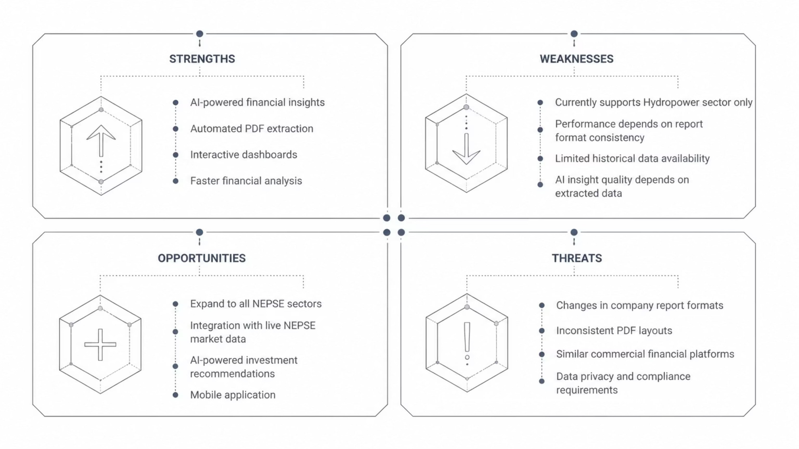
SWOT Analysis
A structured assessment of the platform's internal capabilities and external market dynamics.
Key Strength
Primary Risk
Biggest Opportunity
Automated end-to-end pipeline from PDF ingestion to AI-generated narrative — no comparable tool exists in the NEPSE ecosystem.
PDF layout inconsistency across companies may affect extraction accuracy — mitigated by a robust metric mapping engine.
Expanding the standardized metric framework to cover all NEPSE sectors represents a significant addressable market.
Notes:
8

Slide 10
Extract
Analyze
Visualize
Interpret
Automated PDF parsing of NEPSE quarterly reports
Structured financial metrics & ratio computation
Interactive dashboards & trend charts
AI-generated executive summaries & insights

Slide 11


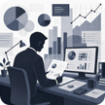



Applications & Use Cases
The platform serves a broad spectrum of stakeholders across the NEPSE investment ecosystem — from retail investors to corporate management teams.
Retail Investors
Traders
Financial Analysts
Brokerage & Investment Firms
Analyze company performance and understand quarterly reports without accounting expertise. Track growth trends and make informed buy/sell decisions.
Monitor quarterly financial performance, identify improving or declining companies, and compare competitors to time market entries more effectively.
Reduce manual report analysis time, generate standardized comparison reports, and focus analytical effort on interpretation rather than data gathering.
Screen companies efficiently, support investment research workflows, and accelerate client reporting with automated financial summaries.
Students & Researchers
Corporate Management
Study NEPSE company performance over time, analyze historical financial trends, and conduct academic research on hydropower sector economics.
Benchmark financial performance against sector competitors, monitor company financial health, and evaluate long-term growth trajectories.
Notes:
10

Slide 12
Implementation Status
The project follows a phased development roadmap — core extraction and visualization capabilities are fully implemented, with AI insight generation as the active next phase.
Phase 1 — Complete
1
PDF upload module, pdfplumber extraction engine, MySQL schema design, and metric standardization framework
2
Phase 2 — Complete
FastAPI backend with Dashboard API and Comparison API endpoints, Chart.js interactive visualizations, quarter-over-quarter trend analysis
Phase 3 — Complete
3
LLM integration (Gemini) for AI-generated executive summaries, chart explanations, and comparative financial narratives
4
Phase 4 — Planned
Expansion to additional NEPSE sectors, live market data integration, mobile-responsive enhancements, and investor report downloads
Notes:
11

Slide 13
Thank You
NEPSE Financial Report Analyzer
Notes:
12

